Slide 1
COLOR MODELS

Slide 2
OverView
Color model
Visible light Spectrum
Color terminology
Energy Spectrum
Additive & Subtractive Mixing
CIE standard
RGB color model
CMY color model (also, CMYK)
HSV color model
HLS color model

Slide 3
COLOR MODELS
A color model is a method for explaining the properties or behavior of color within some particular context.
  Mathematical model in which a color is represented as numbers.
  Forms a 3D coordinate system and each point represents a color
No single color model explains all aspects of color, so different models are used to describe the different perceived characteristics of color

Slide 4
Color
Light is a narrow frequency band within the electromagnetic spectrum (380-750 nm).
Each frequency value within the visible band corresponds to a distinct color.
At low frequency end is red color and highest frequency is violet color.
The various colors are described in terms of either frequency f or wavelength λ of electromagnetic wave.
The colors that we see in the world around us are generally not pure colors consisting of a single wavelength.

Slide 5
Color
The combination of frequencies present in the reflected light determines what we perceive as the color of the object.
Rather, color sensation results from the dominant wavelength of the light reflecting off or emanating from an object.
The dominant frequency is called as HUE .

Slide 6
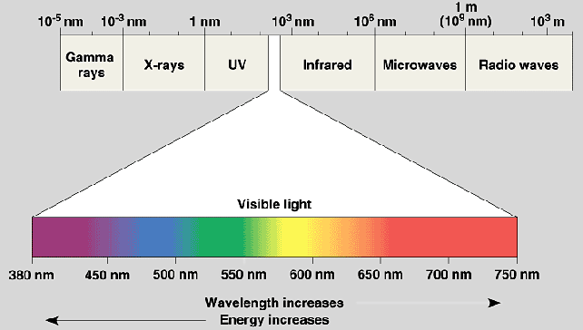
Color

Slide 7
Color Terminology
Hue – the dominant frequency is called hue or simply color
Monochromatic color – a color that is created from only one wavelength.
Brightness or Luminance : perceived intensity of light.
Purity or saturation : Describes how "pure” the color of light appears. Saturation is a matter of how much white light is added in. The less white light, the more saturated the color.(how strong a color is)
Lightness is how much black is in the color.
Chromaticity: Refers to two properties of color characteristics purity and dominant frequency
Hue and saturation are elements of chrominance. Lightness is a matter of luminance.

Slide 8
Color Terminology
Additive color systems – based on adding colored light (as in computer monitors). A combination of all colors gives white.
Subtractive color systems – based on adding pigments (as in printing). A combination of all colors gives black.

Slide 9
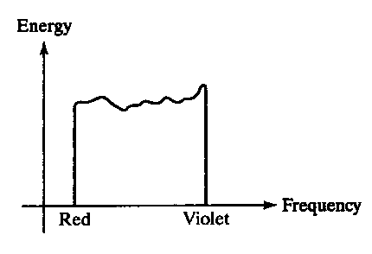
Physical properties of light
Energy emitted by a white-light source has a distribution over the visible frequencies as shown
The distribution showing the relation between energy and wavelength (or frequency) is called energy spectrum.
Each frequency component from red to violet contributes more or less equally to total energy.
The color of source are descibred as white.

Slide 10
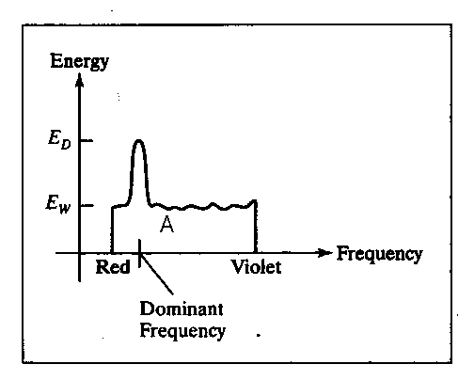
Physical properties of light
The light has color corresponding to the dominant frequency
This distribution may indicate:
a dominant wavelength (or frequency) which is the color of the light (hue),E_{D}
Contributions from the other frequencies produces white light of energy density E_{w}
brightness (luminance), intensity of the light (value), is the area A under curve.
purity (saturation), E_{D} - E_{W}
Energy spectrum for a light source with a dominant frequency near the red color

Slide 11
Color definitions
Two different color light sources with suitable chosen intensities can be used to produce other range of colors.
Complementary colors - two colors combine to produce white light.
  Eg: red and cyan, green and magenta, blue and yellow
Color Gamut:color models used to describe combination of light, in terms of hue, use three colors to obtain wide range of colors.
Primary colors - (two or) three colors used for describing other colors
Two main principles for mixing colors:
  Additive mixing & Subtractive mixing

Slide 12
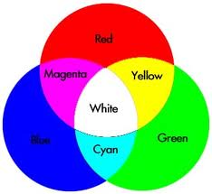
Additive mixing
This system express a color D, as the sum of certain amount of primaries.
Overlapping gives yellow, cyan, magenta and white
Typical technique used on color displays

Slide 13
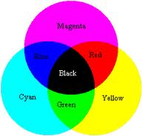
Subtractive mixing
Color pigments are mixed directly in some liquid, e.g. Ink
Primary colors: cyan, magenta and yellow, i.e. CMY
The typical technique in printers/plotters
This system expresses a color, D by means of three tuple in which each of the three values specifies how much of certain color to remove from white in order to produce D.

Slide 14
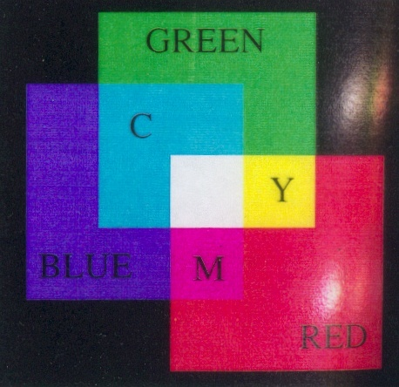
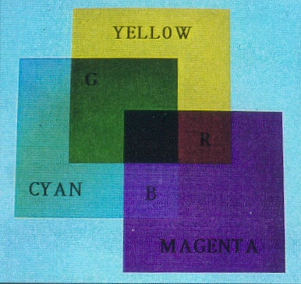
Additive/subtractive mixing

Slide 15
Overview of color models
The human eye can perceive about 382000(!) different colors
Some kind of classification system is necessary; all models use three coordinates as a basis:
CIE standard (XYZ model)
RGB color model
CMY color model (also, CMYK)
YIQ color model
HSV color model
HLS color model

Slide 16
CIE Color Primaries
The CIE (International Commission on Illumination) color primaries is referred as X, Y, and Z .
X, Y, and Z are “artificial primaries,”(imaginary) not visible colors like R, G, and B.
  Just a hypothetical model; to make it machine independent
These primaries can be combined in various proportions to produce all the colors the human eye can see.
In the CIE color model ,a color C is given by
  C = X1*X + Y1*Y + Z1*Z
  XYZ – Vectors in color space X1Y1Z1 – amt of standard primaries needed to match C

Slide 17



CIE Color Model on the X+Y+Z = 1 Plane
If we want to consider each component as a percentage of the total amount of light, we can “normalize” the values:
(1)
(2)
(3)
Note: X + Y + Z is the luminance
Also note that x + y + z = 1

Slide 18
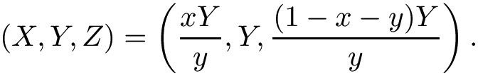
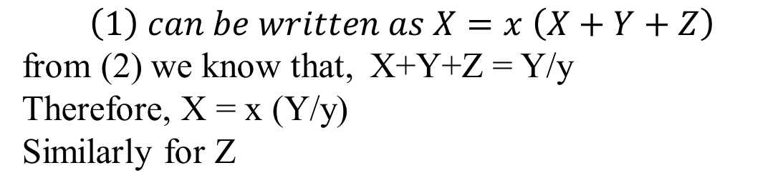
CIE Color Model on the X+Y+Z = 1 Plane
x, y represent chromaticity values and depend on hue and purity.
If we specify colors only with x and y values, we cannot obtain the amounts X, Y, and Z
So, for complete description of any color, we need x, y & Y.

Slide 19
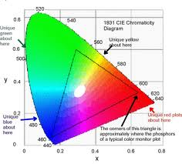
CIE Chromaticity Diagram
Plotting x vs. y for colors in the visible spectrum ,we obtain tongue shaped curve called CIE Chromaticity diagram
Points along the curve are the ‘pure’ colors in the spectrum.
The Line Joining red to violet is called purple line, and is not a part of the spectrum
Interior points specify all the visible color combinations.
The dot corresponds to white light position.

Slide 20
Chromaticity Diagram
The CIE Chromaticity diagram is found useful in the following situations
  Comparing color gamuts of different set of primaries
  Identifying complementary colors
  Determining dominant wavelength & purity of different colors

Slide 21
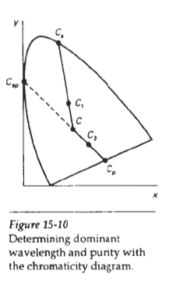
Dominant Wavelength on CIE Color Diagram
Color Gamut are represented in the chromaticity diagram as straight line segments or polygons.
To determine the dominant wavelength of a color C1, draw a line between C through C1 to intersect the spectral curve at Cs. The dominant wavelength is at Cs.
The purity is given by the ratio of distance of C to C1 and distance of C to Cs.
The closer C1 is to the perimeter, the more saturated the color.
Dominant wavelength of C2 is Csp(compliment of Cp) – ‘coz Cp is on the purple line which is not a part of visible spectrum

Slide 22
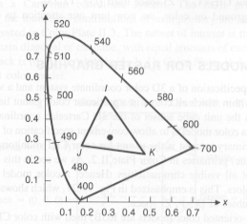
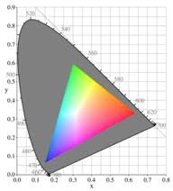
Color Gamuts Represented on CIE Diagram
All colors on the line IJ can be created by additively mixing colors I and J; all colors in the triangle IJK can be created by mixing colors I, J, and K.

Slide 23
Color Concepts
An artist creates a color painting by mixing color pigments with white and black pigments
Shades: Pure color + Black pigment
Tints : White Pigment + original color
Tones : original color + Black +White pigments

Slide 24

RGB model
All colors are generated from the three primaries R,G,B.
various colors are obtained by changing the amount of each primary
Additive mixing (r,g,b), 0≤r,g,b≤1 referred to RGB color model.

Slide 25
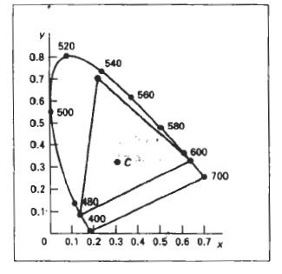
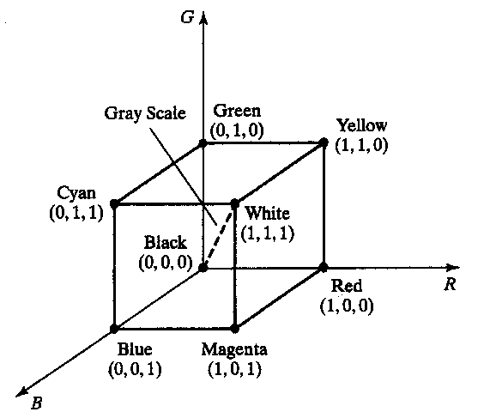
RGB Model
The RGB unit cube defined with R,G,B axes. Each color point within the cube is given as (R,G,B)
A color is expressed as C=RR+GG+BB
Orgin=>black, 1,1,1=>white, .5,.5,.5=>gray
Vertices of cube axes=> primary colors
Other vertices=> complementary colors

Slide 26
YIQ Colour Model
Whereas an RGB monitor requires separate signals for the red, green, and blue components of an image, a television monitor uses a single composite signal
The NTSC colour model for forming the composite video signal is the YIQ model. Same as XYZ model and used in television.
Y represents the luminance IQ represents the hue and purity.
A combination of red, blue and green are chosen for Y parameter to yield standard luminosity curve
Since Y represents the luminance information black-white monitors use only the Y signal.
I contains orange-cyan hue info (flesh-tone) Q contains green-magenta hue information.

Slide 27


YIQ Colour Model
Conversion of RGB values to YIQ values
Calculated using the chromaticity coordinates of the RGB phosphor
Conversion of YIQ values to RGB values can be done with the inverse matrix transformation

Slide 28
CMYK model
CMYK is primarily a printing color model.
Cyan, magenta, and yellow are called the subtractive primaries.
The hard-copy devices produces color pictures by coating a paper with color pigment.
Human eye - See the colors by reflected light which is a subtractive process.

Slide 29
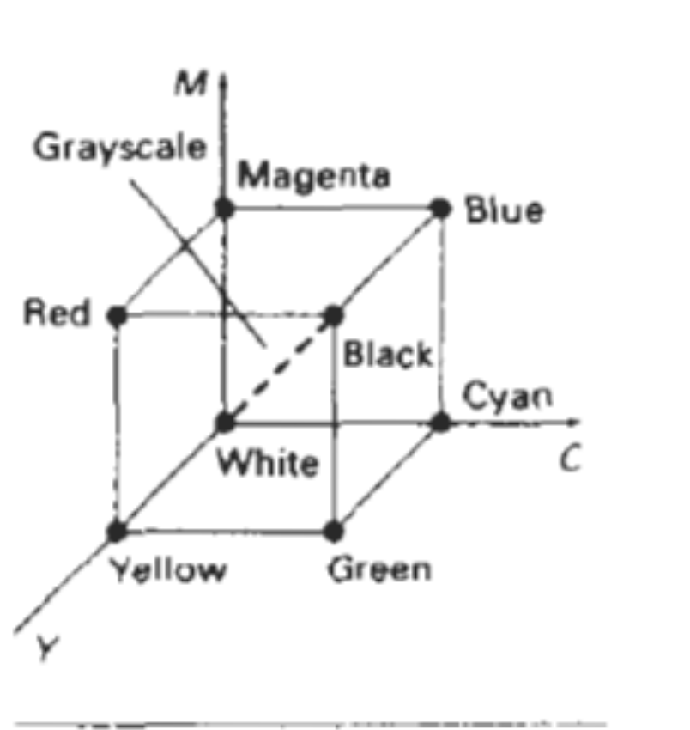
CMYK Model
Cyan, magenta, yellow, and black
Cyan is white light with red taken out.
C = G + B = W – R
cyan can be formed by adding green and blue light. Therefore, when white light is reflected from cyan-colored ink, the reflected light must have no red component. That is red light is absorbed, or subtracted the ~~~~~~~l~
ink.

Slide 30
CMYK Model
Magenta is white light with green taken out.
M = R + B = W - G
Yellow is white light with blue taken out.
Y = R + G = W – B
1,1,1 => black (since all components of incident light are subtracted)
Orgin=>white
CMY model generates a color point with a collection of four ink dots, like a RGB monitor uses a collection of three phosphor dots.
Cyan, magenta, yellow and black dots (black dot coz cyan+magenta+yellow=dark gray instead of black)

Slide 31


CMYK vs. RGB
RGB tO CMY conversion:
CMY to RGB conversion can be done with matrix transformation

Slide 32
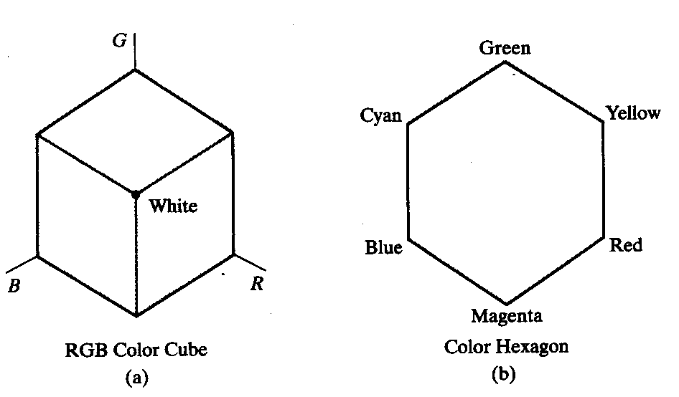
HSV model
Uses color descriptions that are more intuitive to user. User selects a spectral color and then decides a shade, tint and tone
HSV stands for Hue-Saturation-Value
described by a hexcone derived from the RGB cube

Slide 33
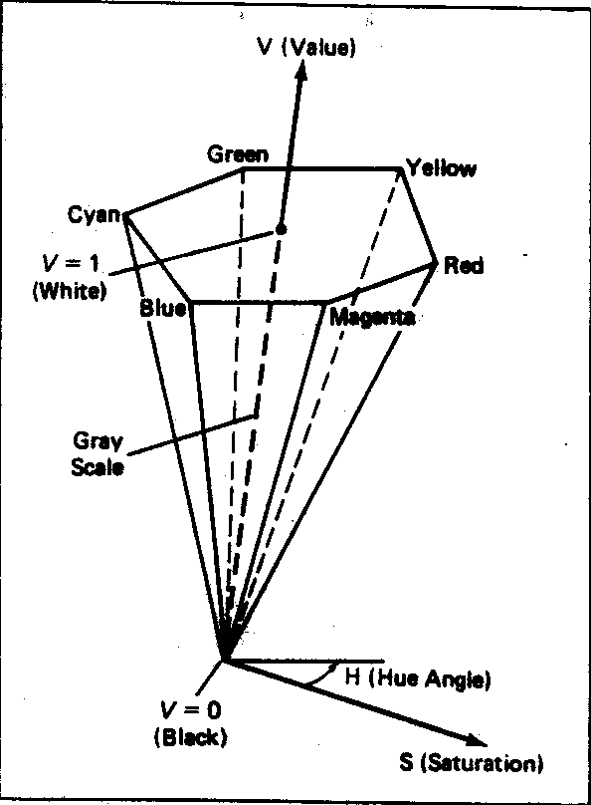
HSV model
Hue (0-360°); ”the color”,
Saturation (0-1); ”the amount of white”
Value (0-1); ”the amount of black”
Top of HSV hex cone is projection seen by looking along principal diagonal of RGB color

Slide 34
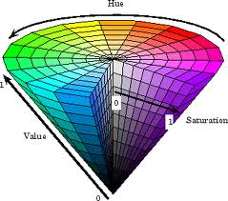
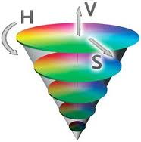
HSV Color Model

Slide 35
HSV color model
Hue: ranges from 0° at red through 360°
Vertices of the hexagon are separated by 60° intervals-Y at 60°, G at 120° etc
Complementary colors 180° opposite
Saturation S ranges from 0 to 1 – ratio of purity of a selected hue to its maximum purity at S=1.
Value V varies from 0 at apex(black) to 1 at top(white).
At
  V=1 and S=1, pure hues
  V=1 and S=0, white
  V=0 and S=0 black

Slide 36
HSV Color model
To get Dark Blue:
  H=240, say V= 0.4 and S= 1
  Adding black decreases V while S is constant
To get Light Blue:
  H=240, V=1 and say S=0.3
  Adding white decreases S while V is constant

Slide 37
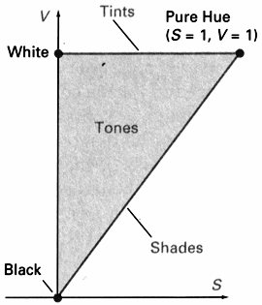
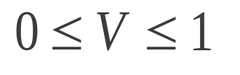
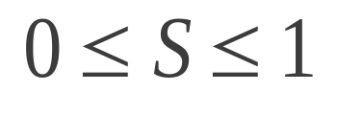
HSV Color Definition
Cross section of the HSV
hex cone showing regions for
shades, tints, and tones.
Shades: S=1
Tints: V=1

Slide 38
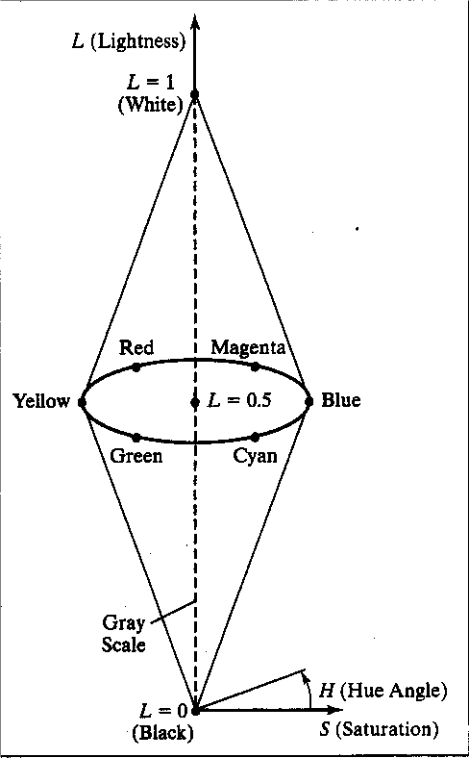
HLS model
Another model similar to HSV
L stands for Lightness
color components:
hue (H)∈ [0°, 360°]
lightness (L)∈ [0, 1]
saturation (S)∈ [0, 1]

Slide 39
Color Models Summary
CIE-XYZ: standard color description
RGB: for monitors
CMY, CMYK: for printers
HSV, HLS: for user interfaces
YIQ: for television (NTSC) (Y=luminance, I=R-Y, Q=B-Y)

